Slide 1
Forces
Dr. Jacob Moore
Associate Professor of Engineering
Penn State Mont Alto

Slide 2

Forces
A force is any influence that would cause a body to accelerate.
Anything you would call a push or a pull.
Each force has three distinguishing characteristics.
Magnitude
Direction
Point of Application

Slide 3
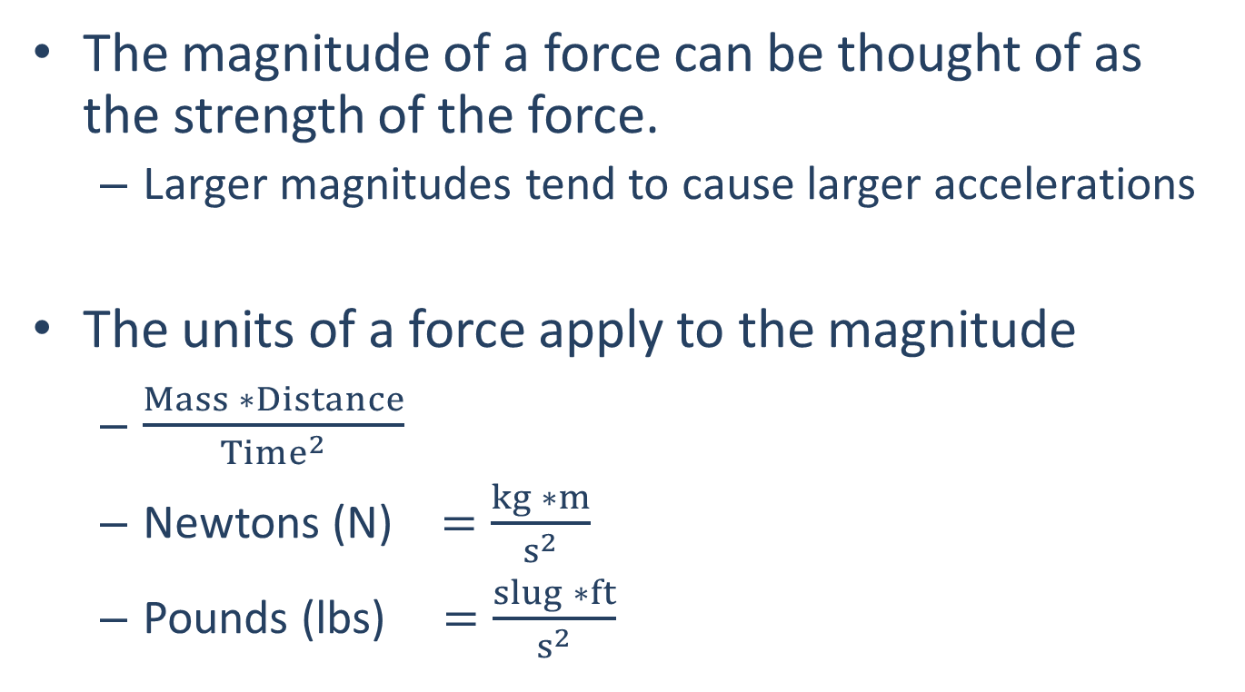
Magnitude
The magnitude of a force can be thought of as the strength of the force.
Larger magnitudes tend to cause larger accelerations
The units of a force apply to the magnitude
$\frac{Mass ∗Distance}{Time^{2}}$
Newtons (N) $=\frac{kg ∗m}{s^{2}}$
Pounds (lbs) $=\frac{slug ∗ft}{s^{2}}$

Slide 4


Direction
Forces also have a direction as indicated by a vector.
When we add or subtract vectors, we will need to take both the magnitude and direction into account.
Vector quantities are represented visually by an arrow, sometimes with the magnitude and angles labeled
In equations vectors are represented as a variable with an arrow over top of it. Often with subscripts used to distinguish forces from one another
$$F = 600 N$$
$${\vec{F}}_{push}$$

Slide 5

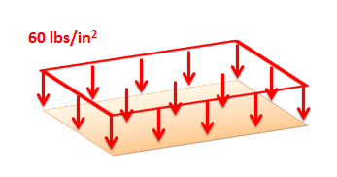
Point of Application
We can model forces as either having a single point of application or being distributed over some area or volume.
Point forces have a single point of application and are modeled as a single vector.
Distributed forces have a point of application that is distributed over a line, surface, or volume. They are modeled as fields of vectors.

Slide 6
Some Common Forces
Some common forces that you will see in many mechanics problems..
Pushing or pulling forces
Gravity forces
Normal or reaction forces
Friction forces
Tension in cables, ropes, or chains

Slide 7
Thanks for Watching
See other engineering mechanics videos and access the full tool at…

